Slide 1
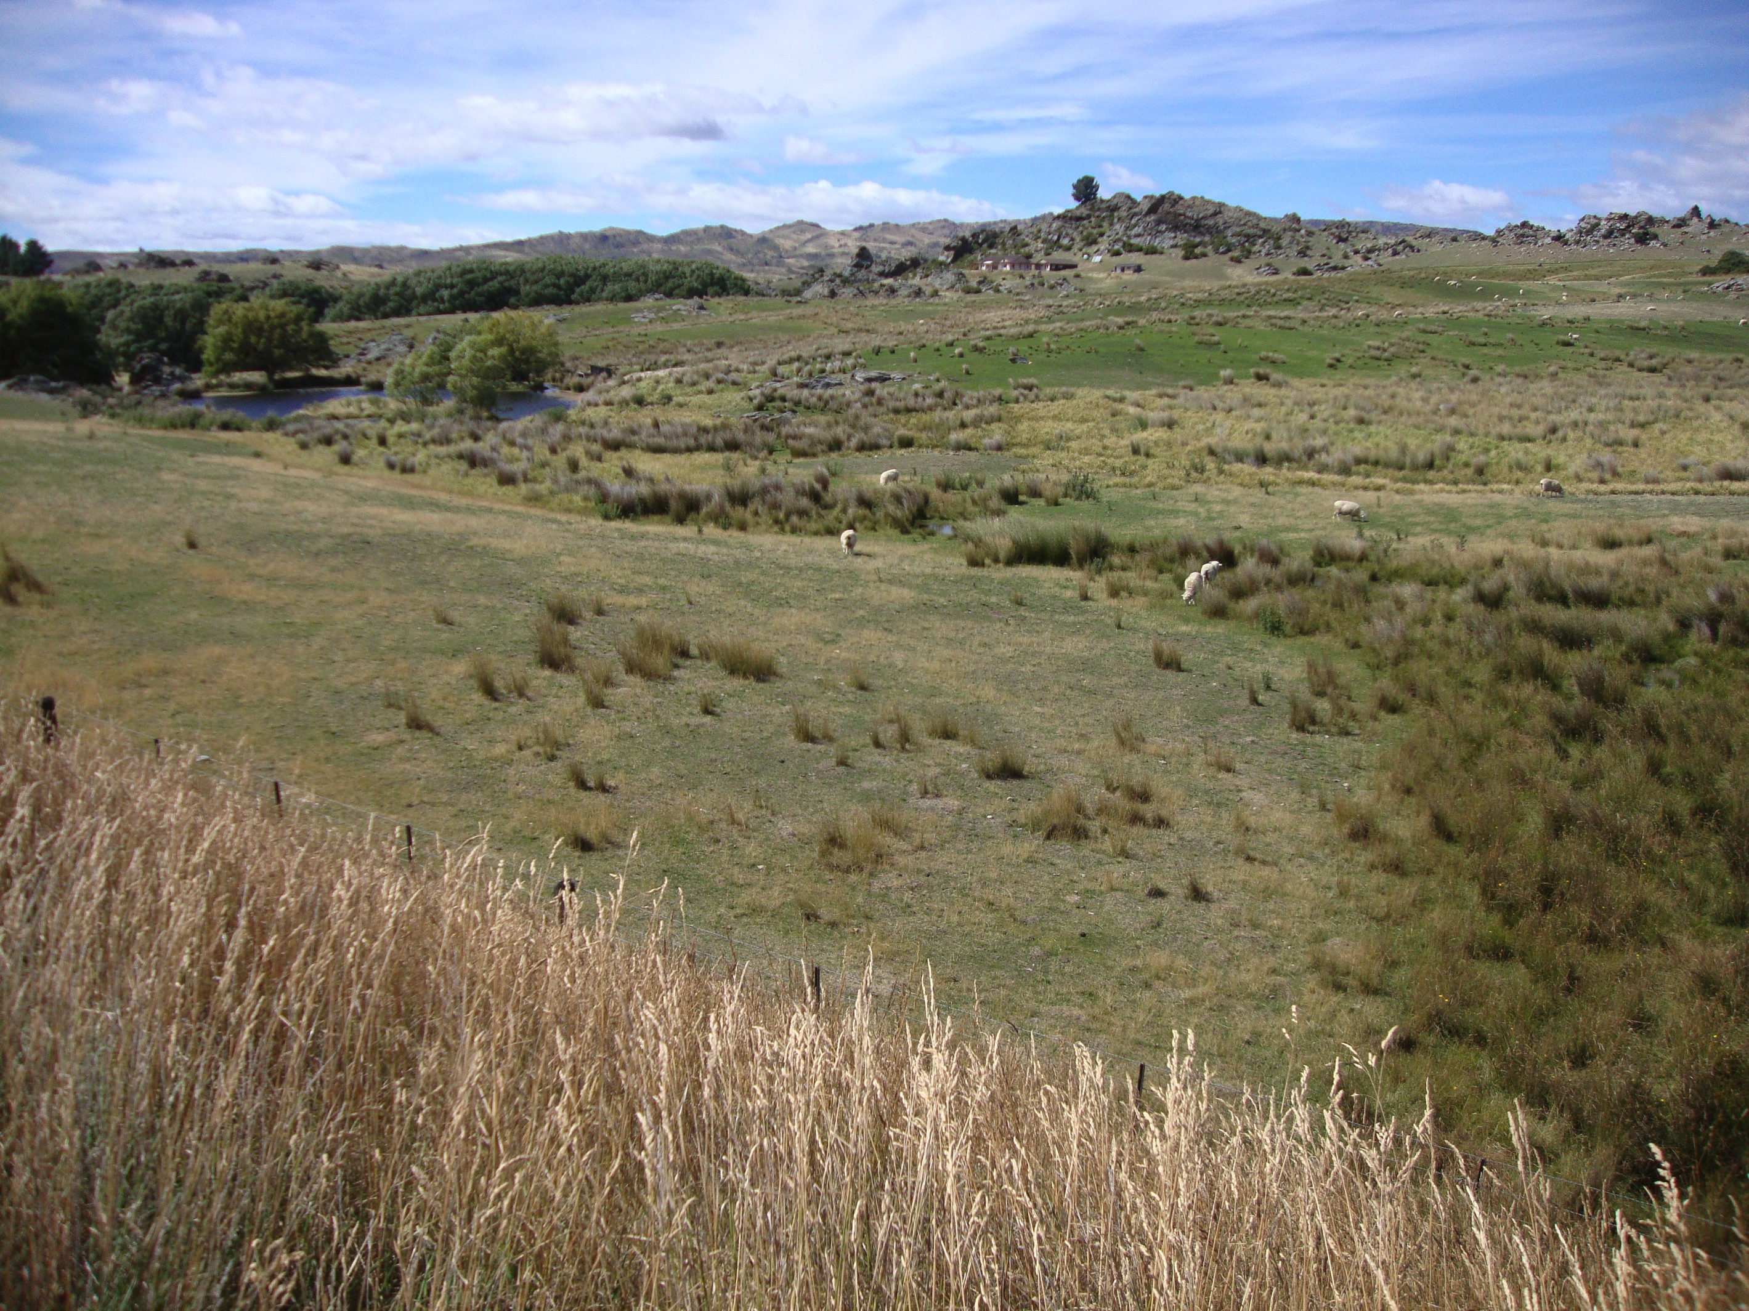

The Landscape holds the key to Hydrological Modelling
Hubert H.G. Savenije
Contributions by:
Fabrizio Fenicia
Hessel Winsemius
Shervan Gharari
Laurene Bouaziz
Honkai Gao
Tanja Euser
Marijn Piet

Slide 2
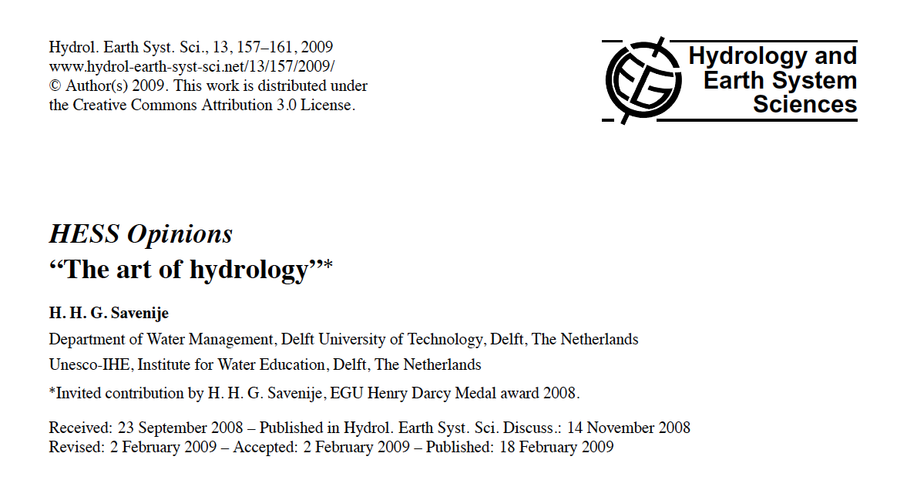
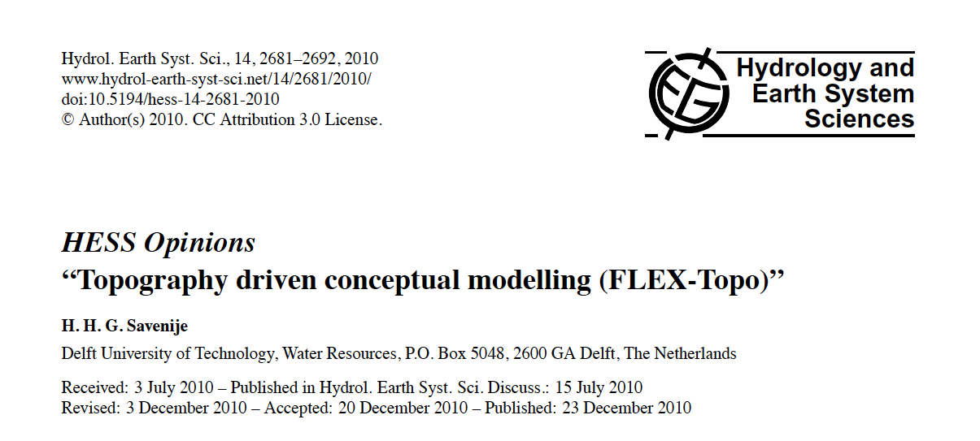
Landscape-driven hydrological modelling

Slide 3
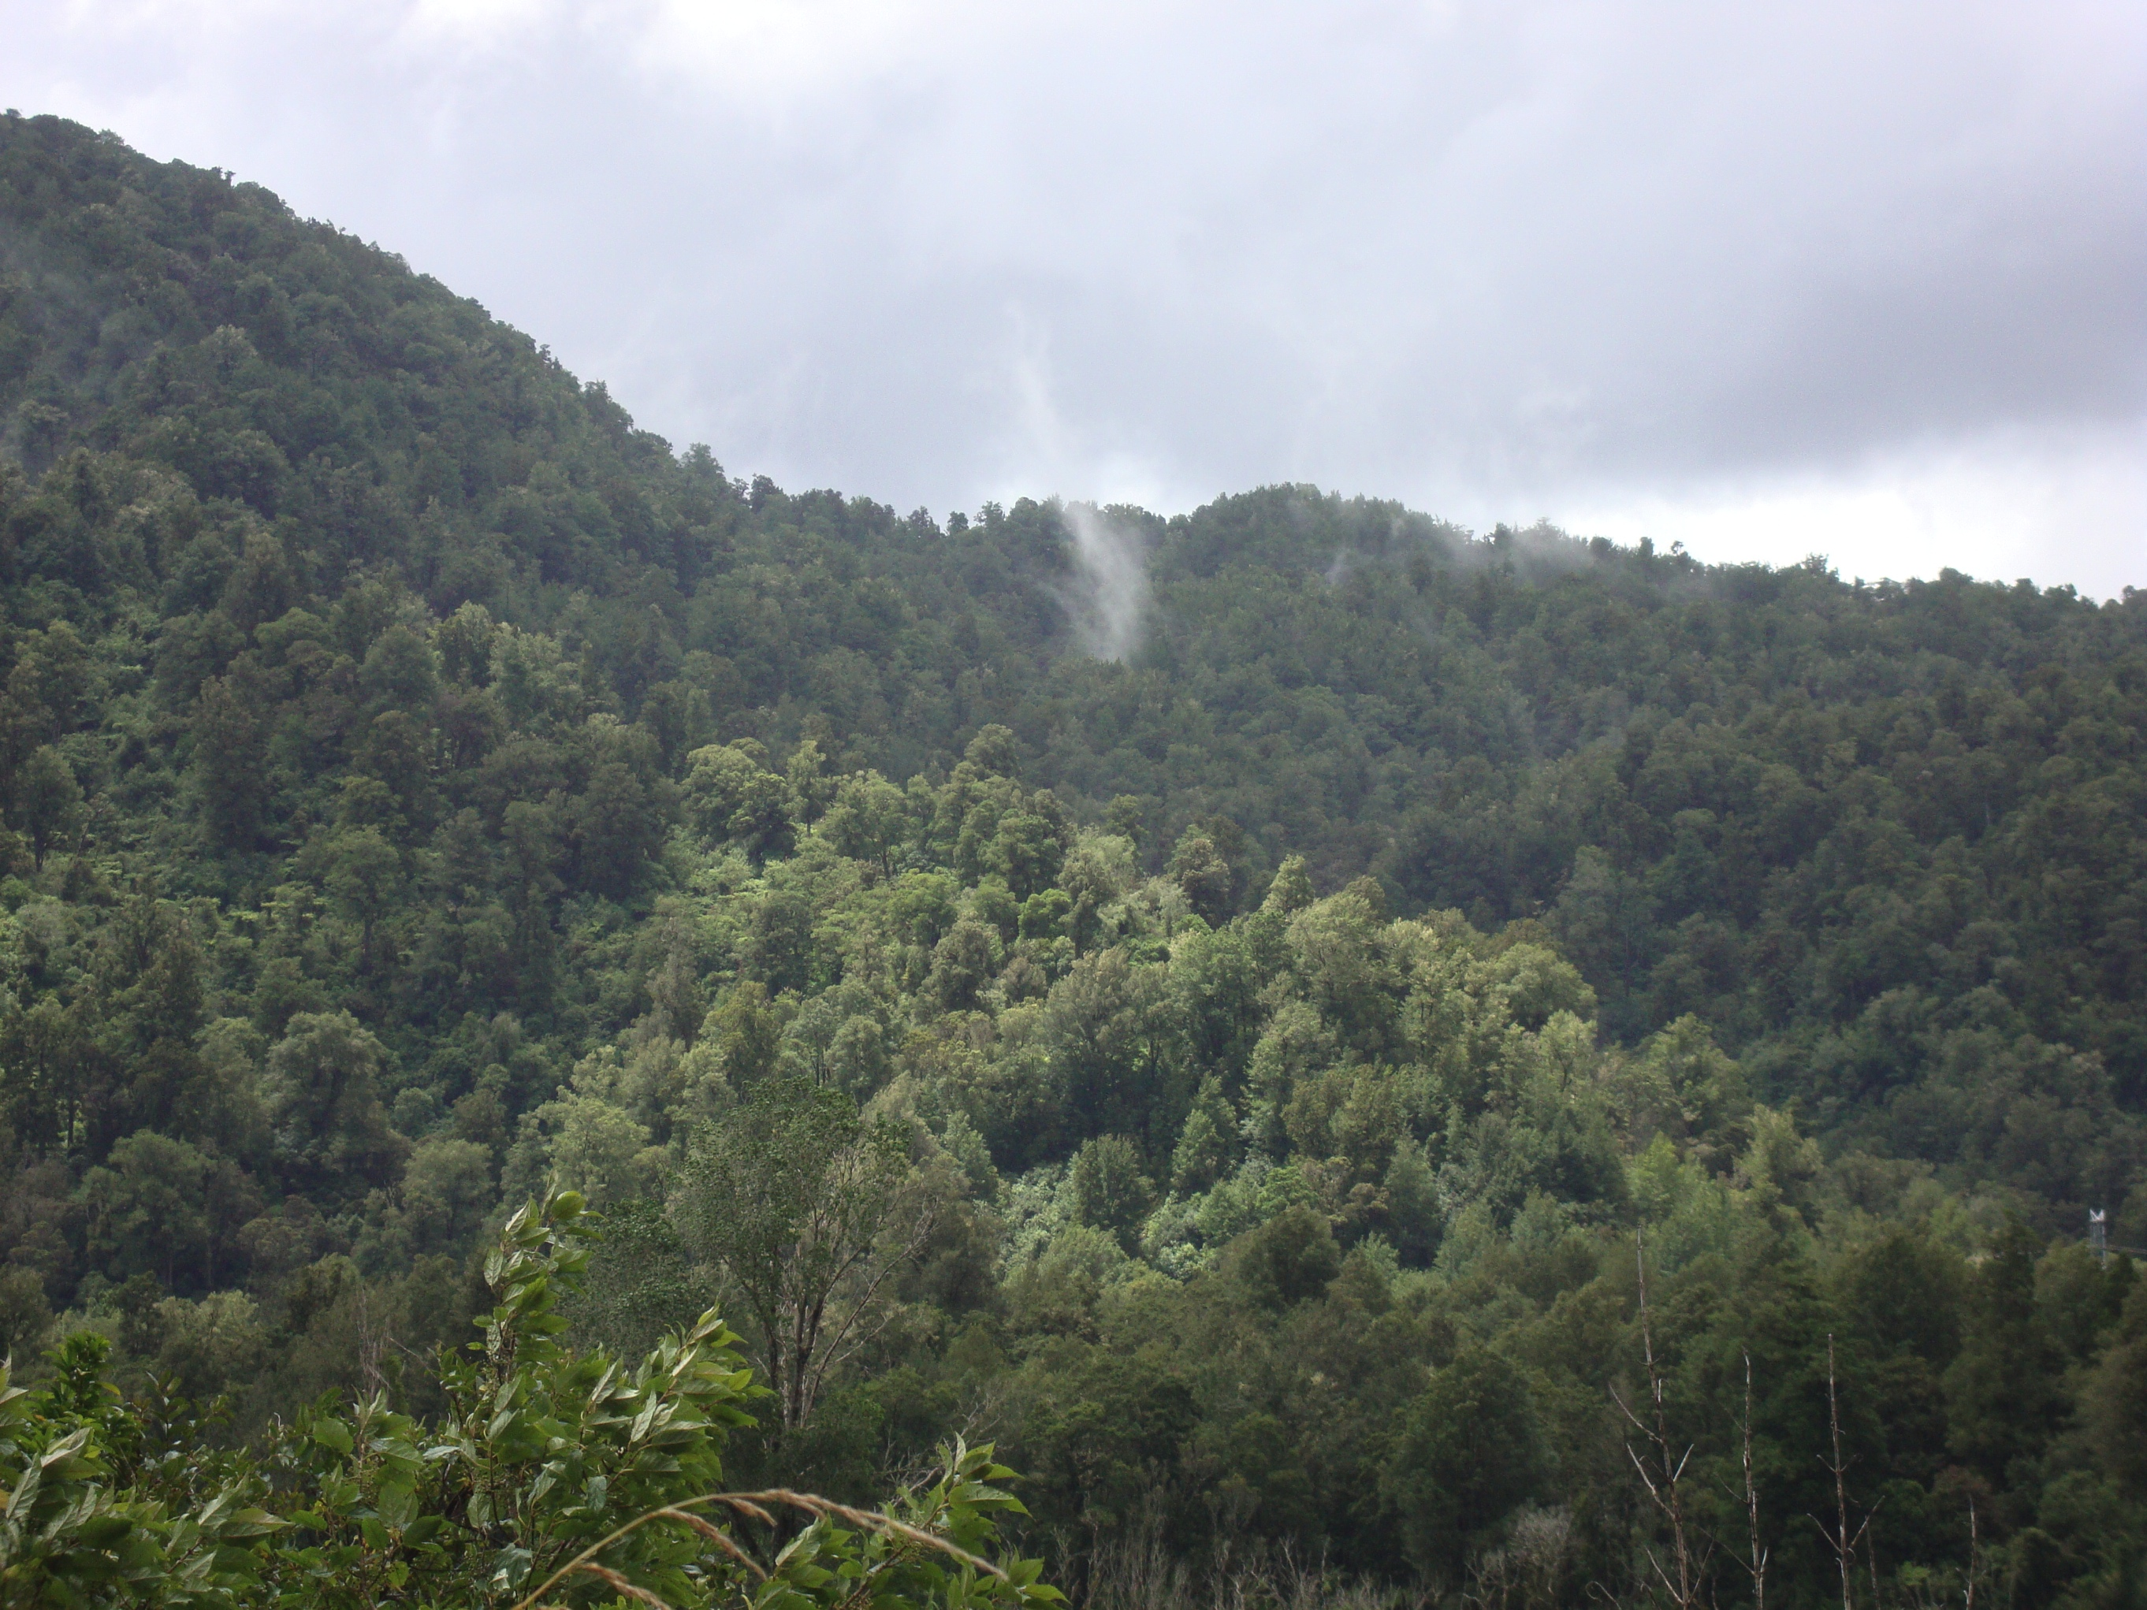
Can we read the landscape and translate it into model structures ?

Slide 4
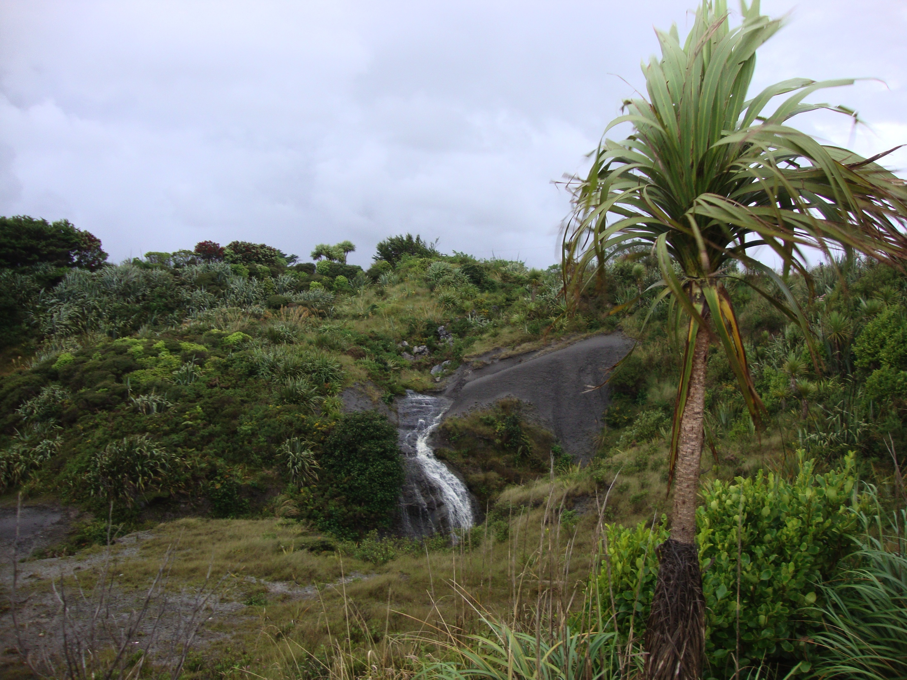
How can we map Landscape to Model Space ?
Landscape having:
shape, structure and land cover

Slide 5
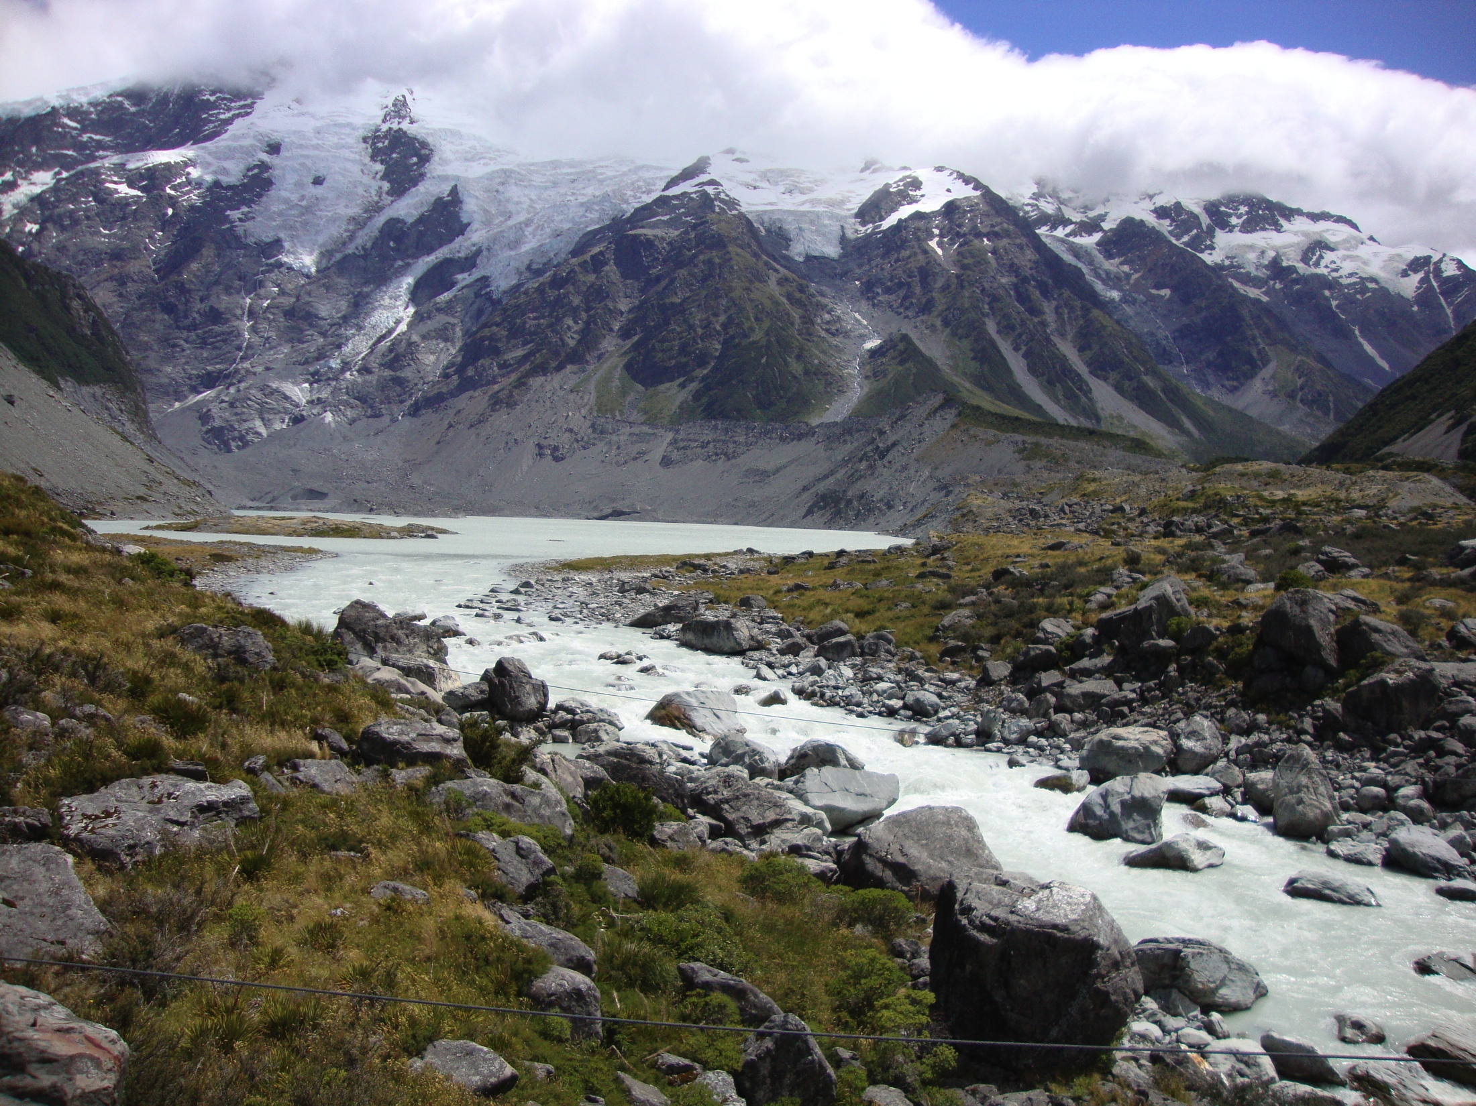
Different landscapes sometimes map similarly
Weierbach and Wollefsbach
Versus
Huewelerbach

Slide 6
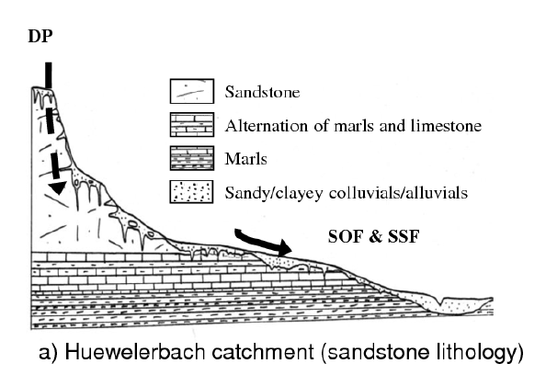
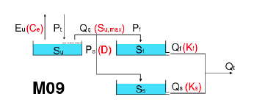
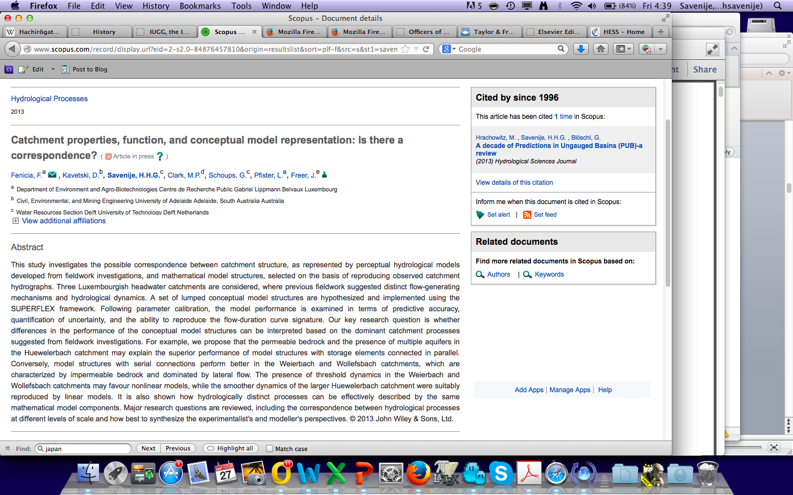
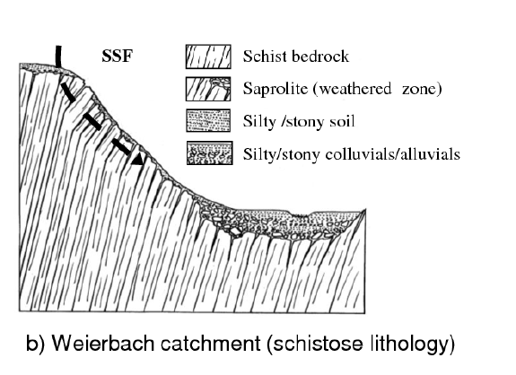
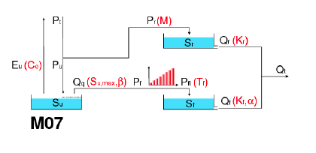
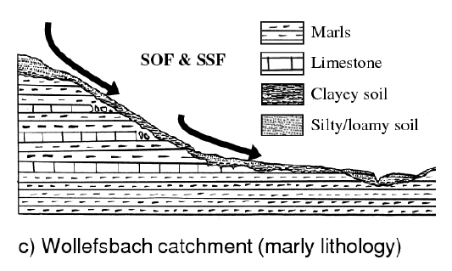
Fenicia et al. 2013

Slide 7
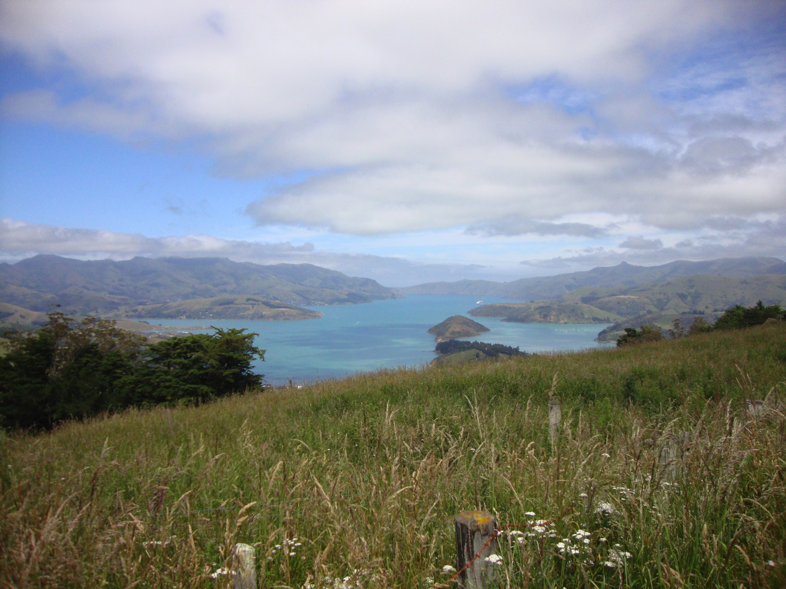
Different hillslopes map similarly
Free after: Jeff McDonnell (2013)

Slide 8
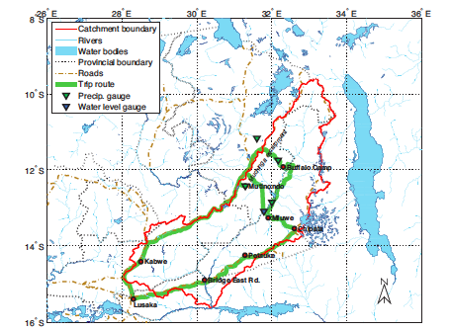
Reading the Landscape in Ungauged Basins
The Luangwa
Winsemius et al.,
2006, 2008, 2009

Slide 9
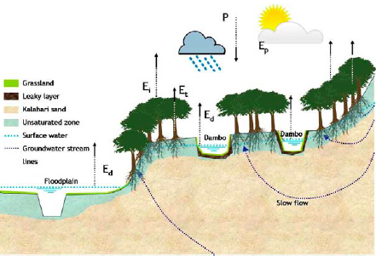
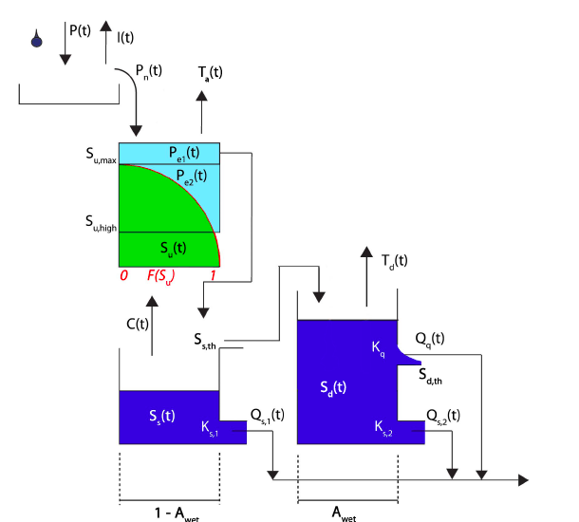
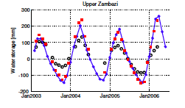
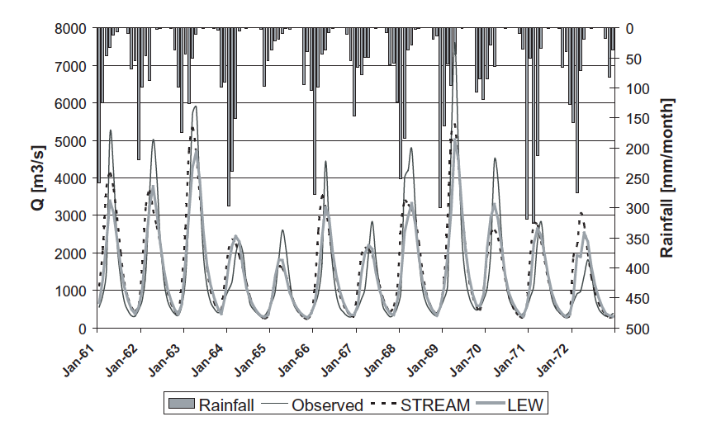
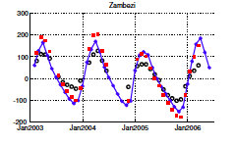
Winsemius et al., 2006, 2008, 2009

Slide 10
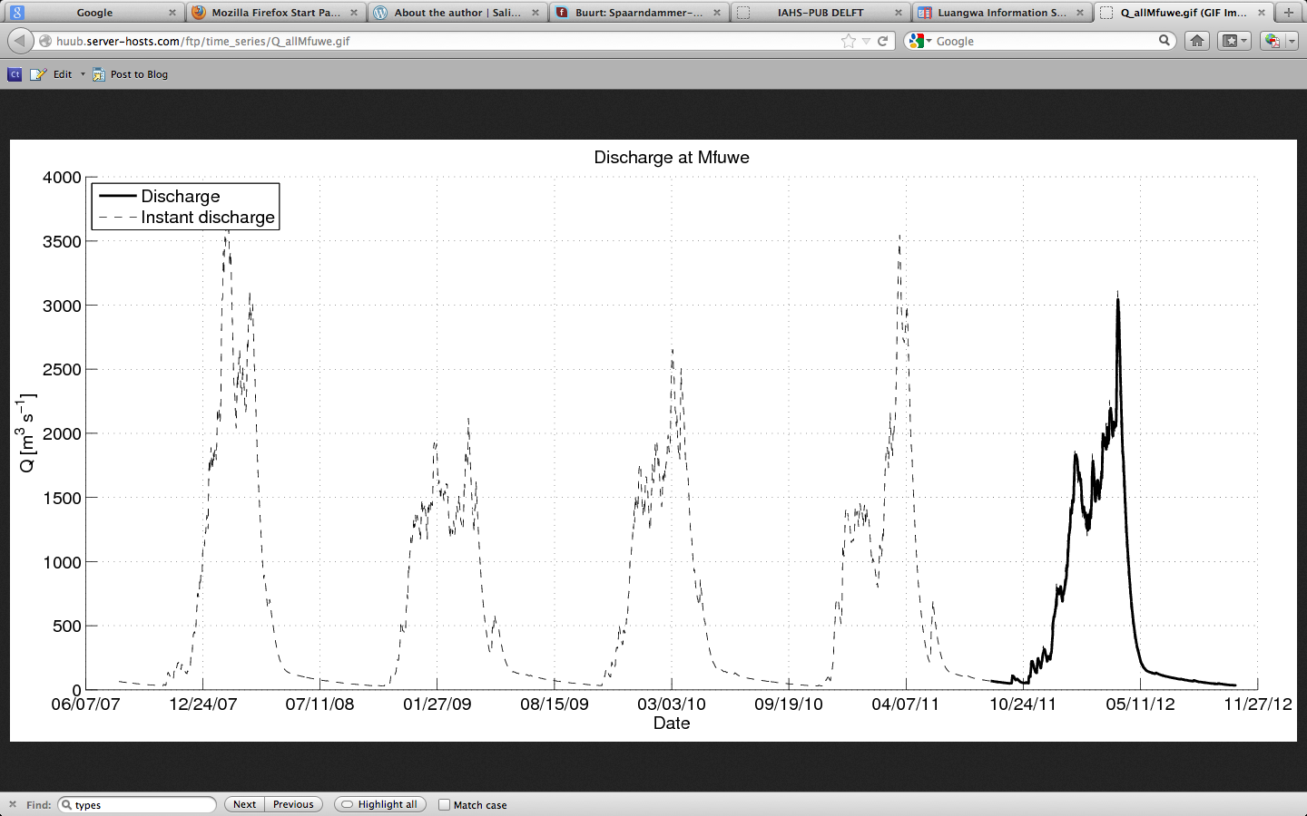
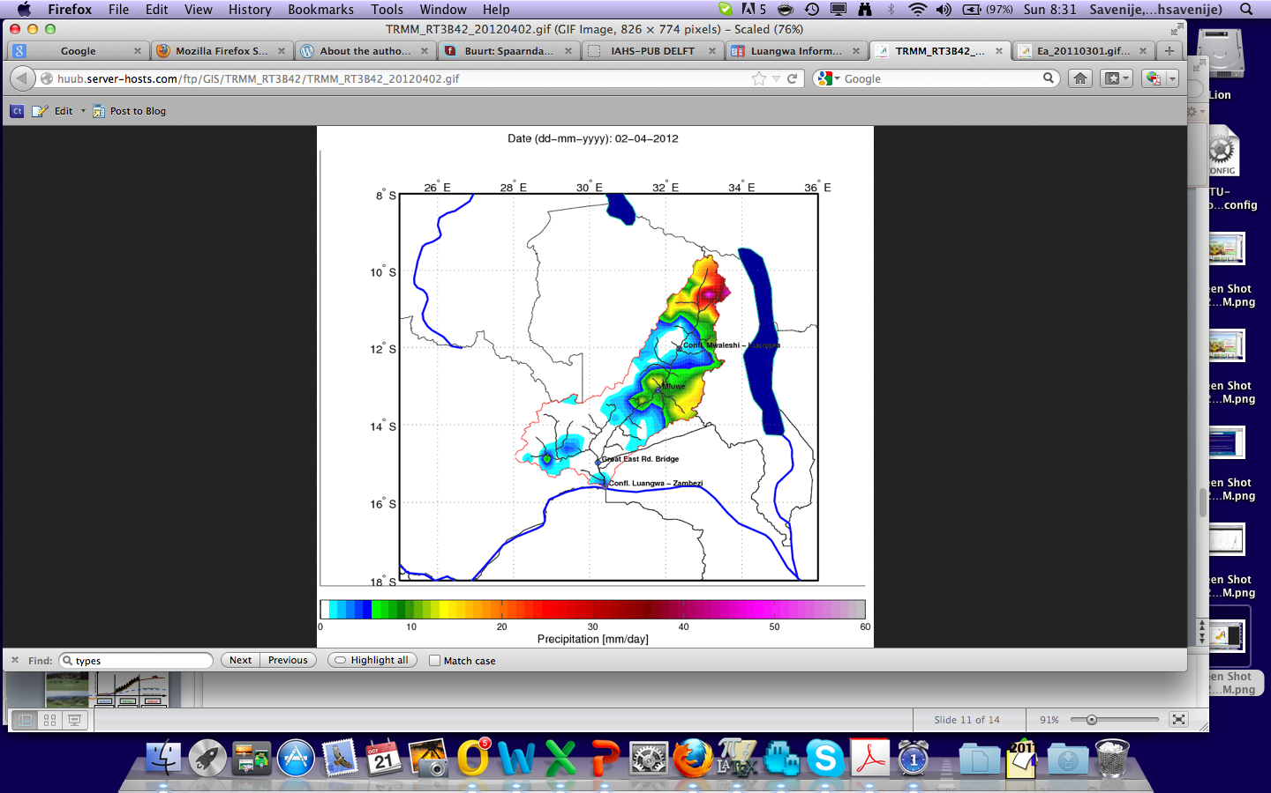
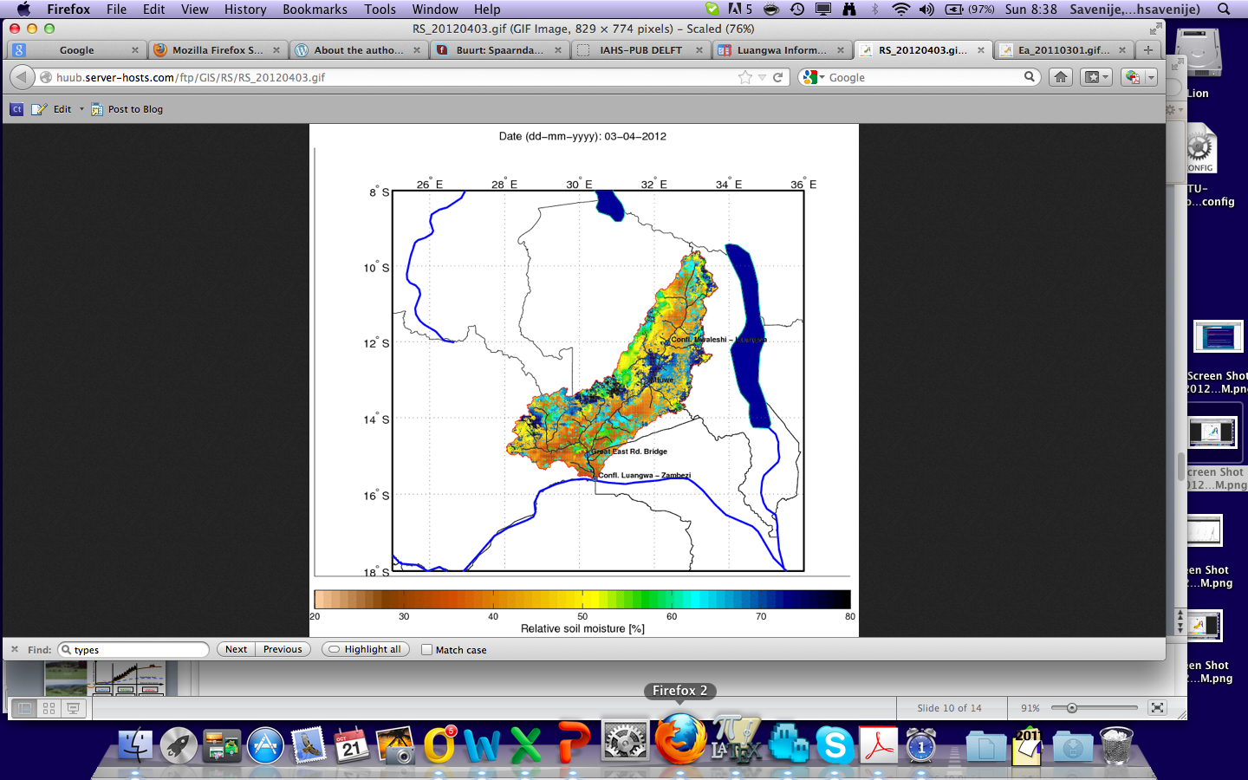
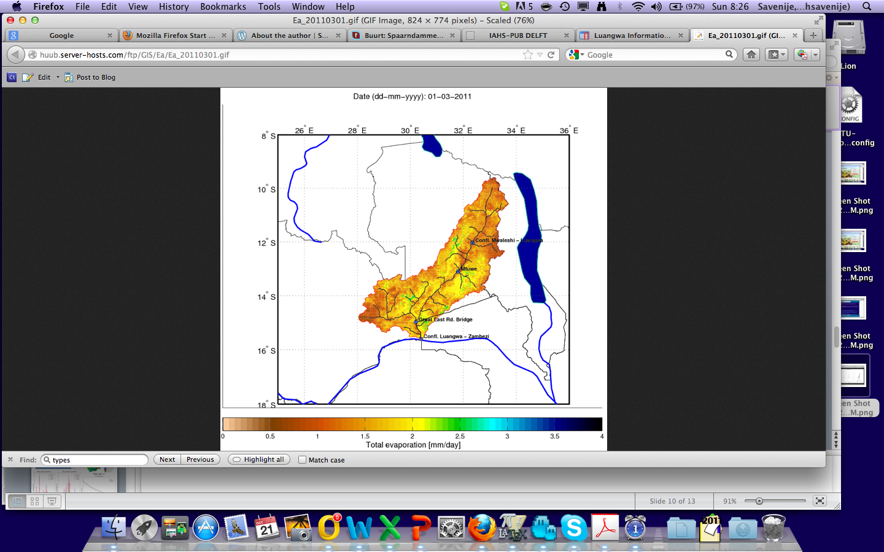
Lumped conceptual model with distributed forcing and stock accounting

Slide 11
But Landscape Matters !
Key to upscaling, downscaling and transposition
And landscape can be identified by independent information from DEM and land cover

Slide 12
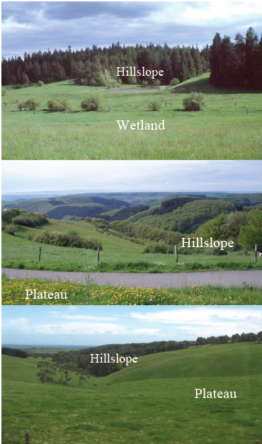

Different landscape units ; different hydrological behaviour; different model structure
Elevation above stream
Groundwater level
Distance from stream
wetland
hillslope
plateau
SOF mechanism
SSF mechanism
DP & HOF mechanisms
Topography driven conceptual modeling, H.H.G. Savenije

Slide 13
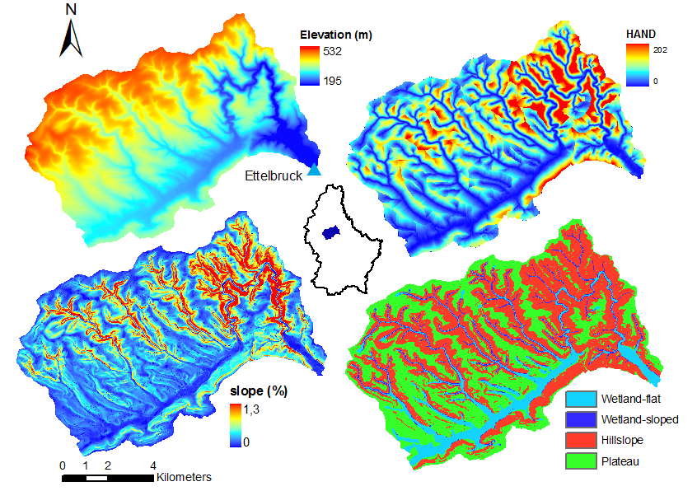
Wetland
Hillslope
Plateau
Gharari et al., (2011) HESS

Slide 14
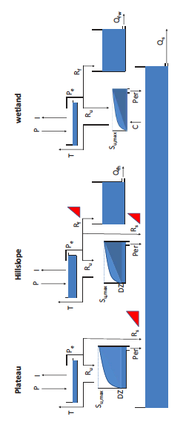
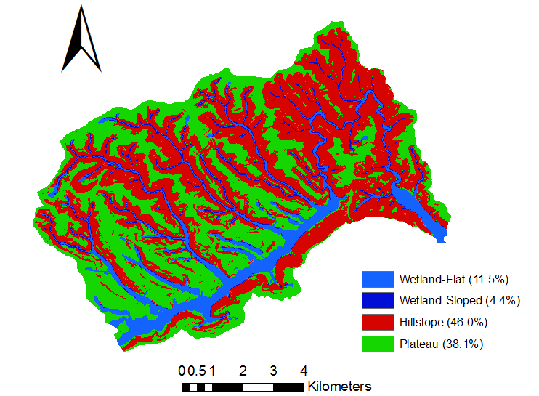
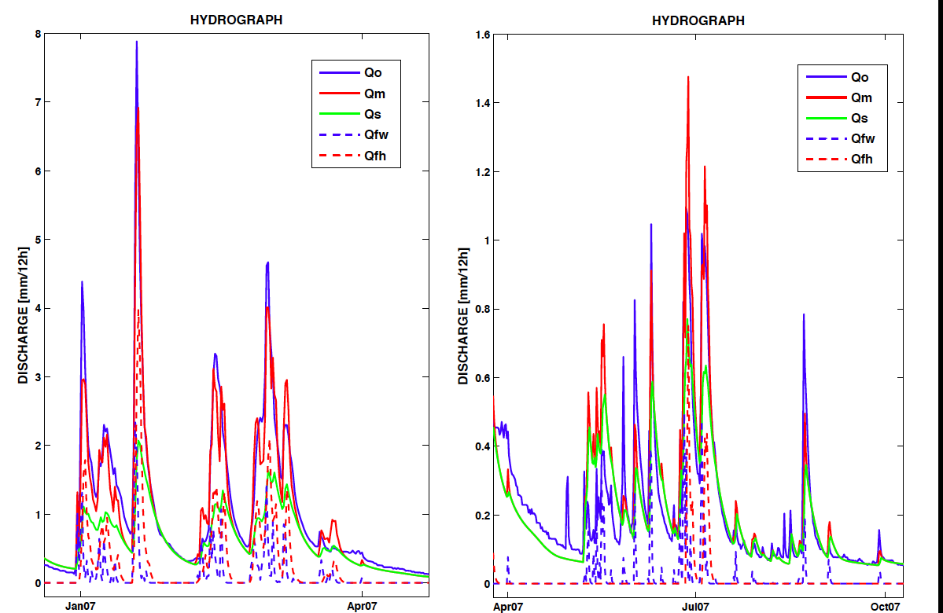
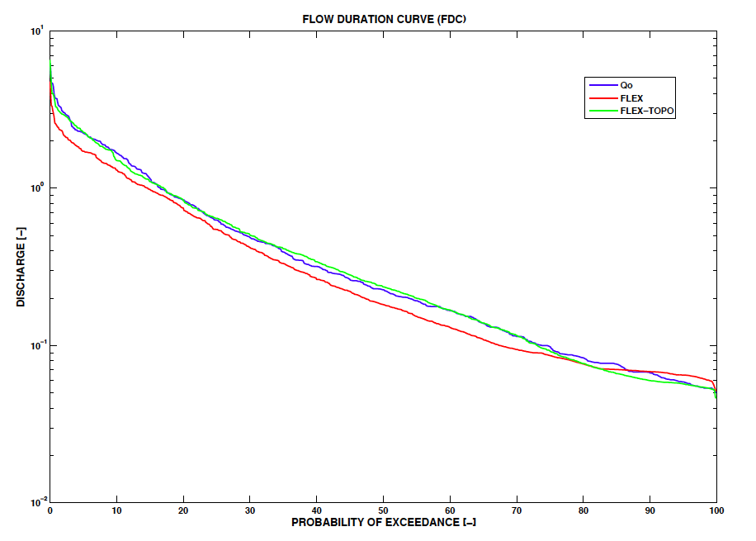
Wet season (winter)
Dry season (summer)
Example of the Wark, Luxembourg, (Gharari et al., 2011)

Slide 15
More Realism, Less Calibration
More parameters, but
Also additional relations between parameters
Parameters have more physical meaning
We obtained reliable predictions even without calibration
Ongoing work by Shervan Gharari in HESSD, 2013

Slide 16
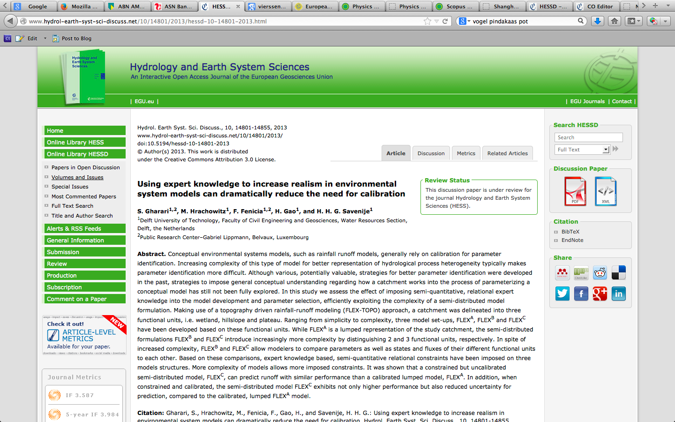

Slide 17
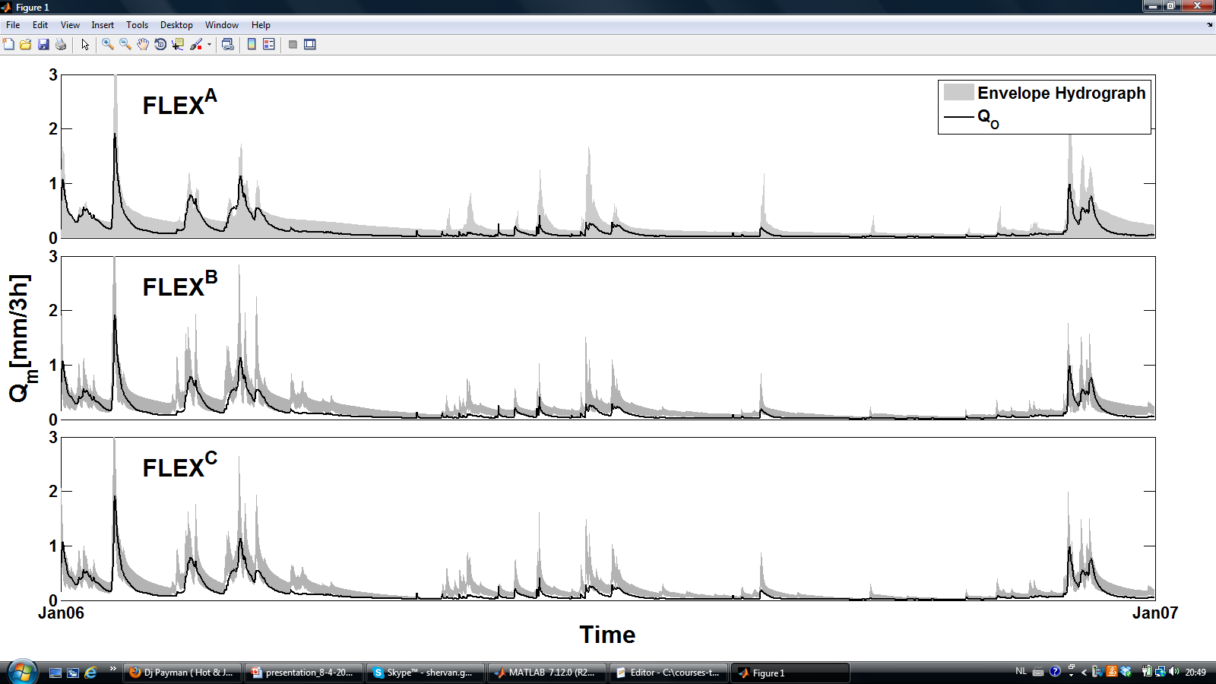
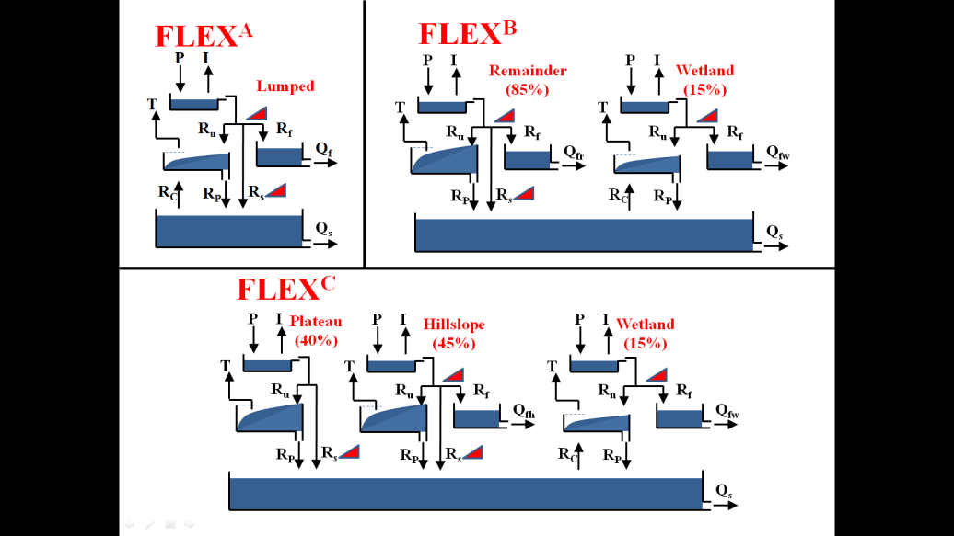


Un-calibrated but constrained
NS = 0.13
NS = 0.64
NS = 0.71

Slide 18
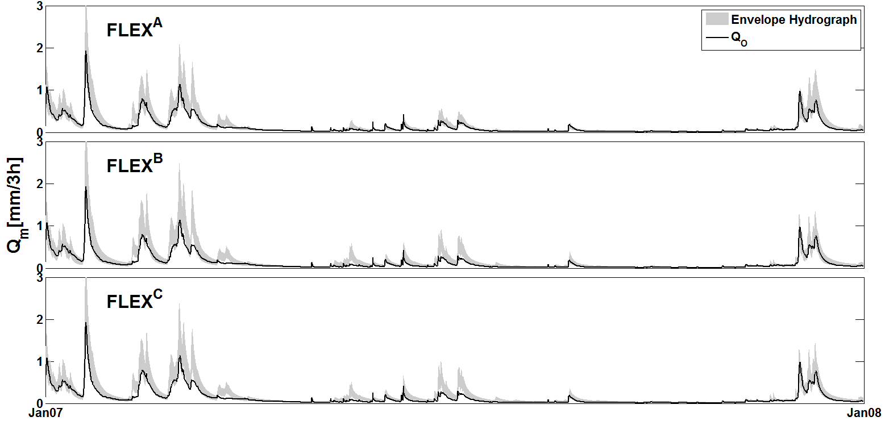
Calibrated and constrained
NS = 0.91
NS = 0.87
NS = 0.88

Slide 19
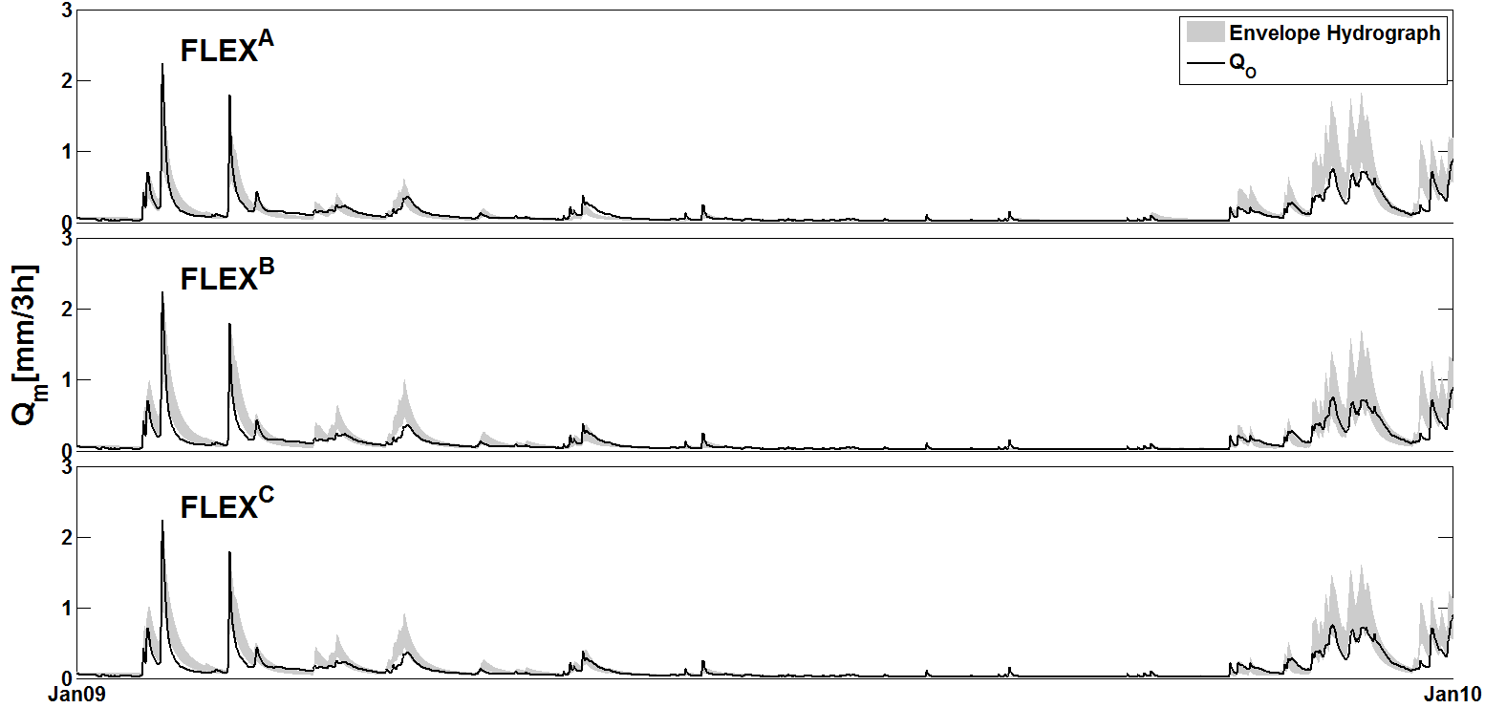
Validated for calibrated and constrained
NS = 0.75
NS = 0.80
NS = 0.80

Slide 20
An example from a semi-arid mountainous catchment in China with completely different landscapes
by Honkai Gao et al. in HESS

Slide 21
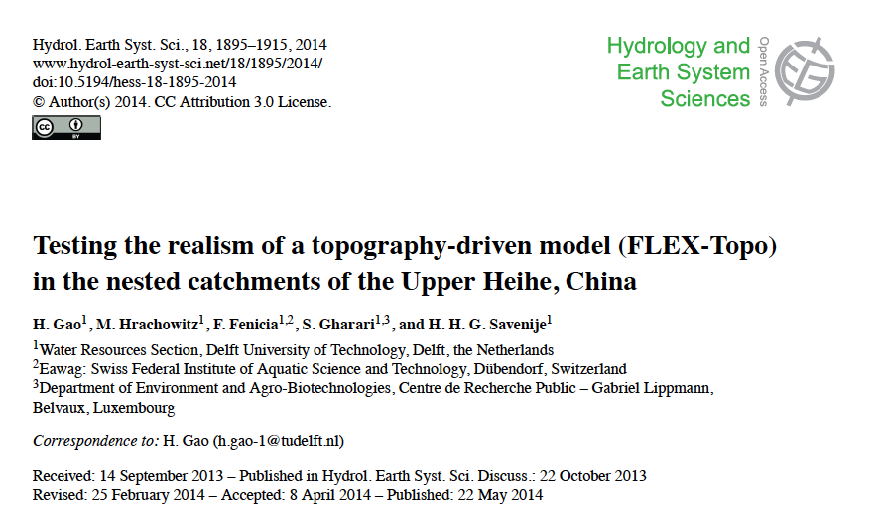

Slide 22
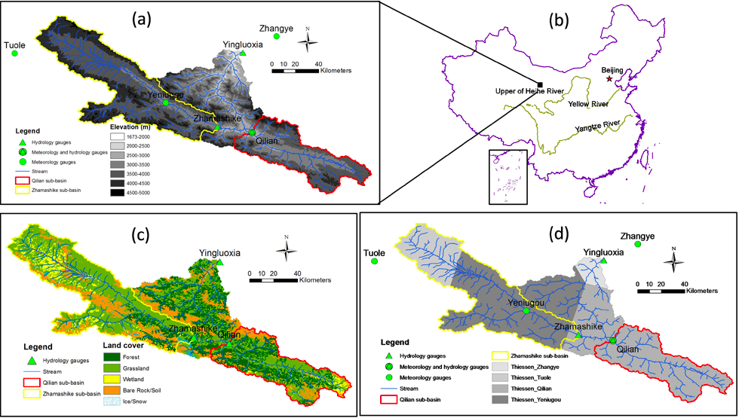
Chinese Mountainous Arid Basin

Slide 23
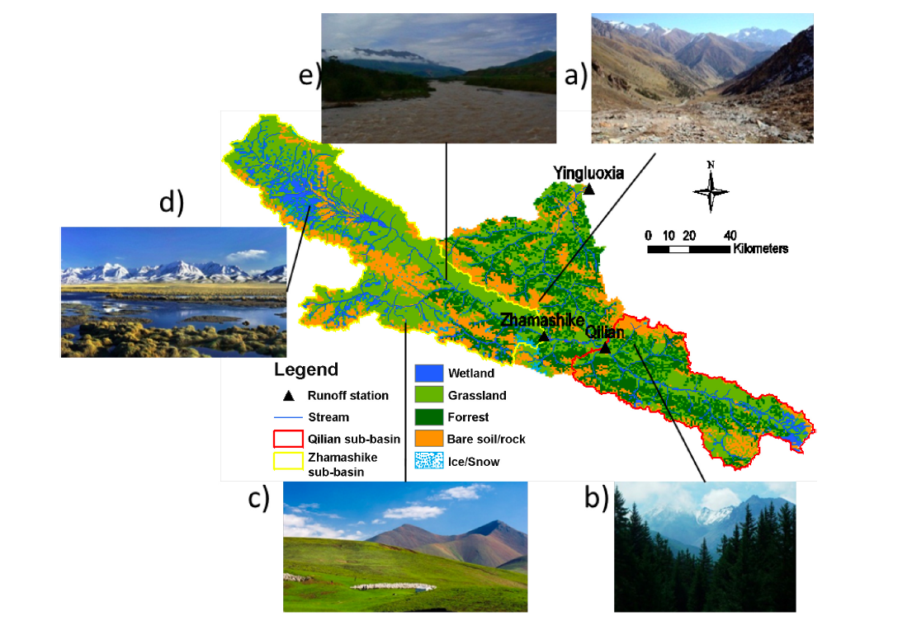
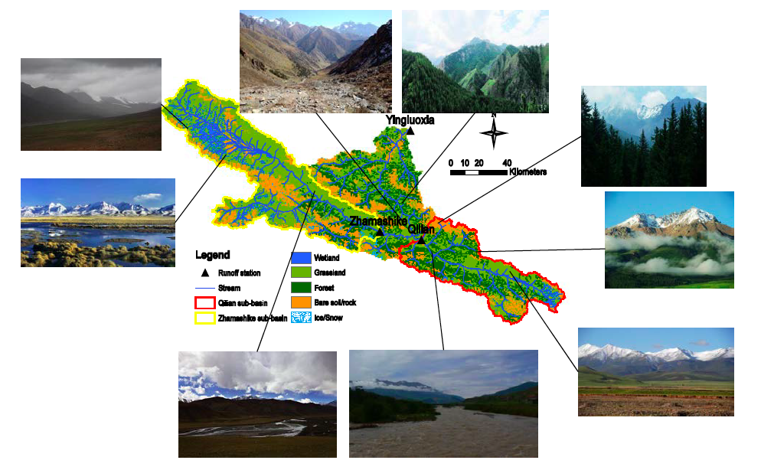
Hei He Basin

Slide 24
Land Cover
Classification in:
Wetland
Terrace
Grass hillslope
Forest Hillslope
Bare mountain
Combining Terrace and Wetland

Slide 25
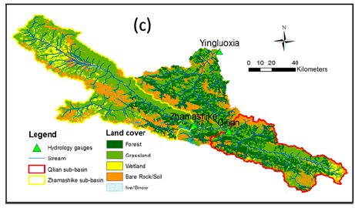
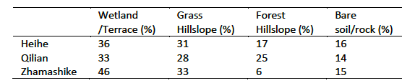
Classification per sub-basin

Slide 26
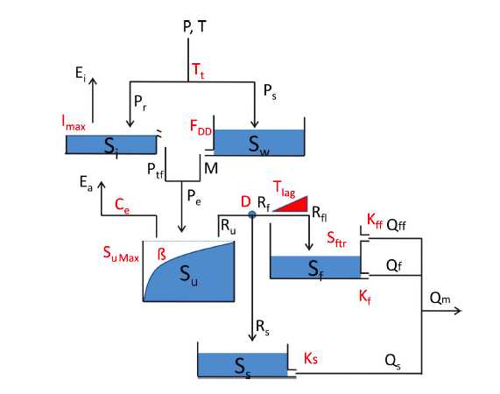
Lumped model structure

Slide 27
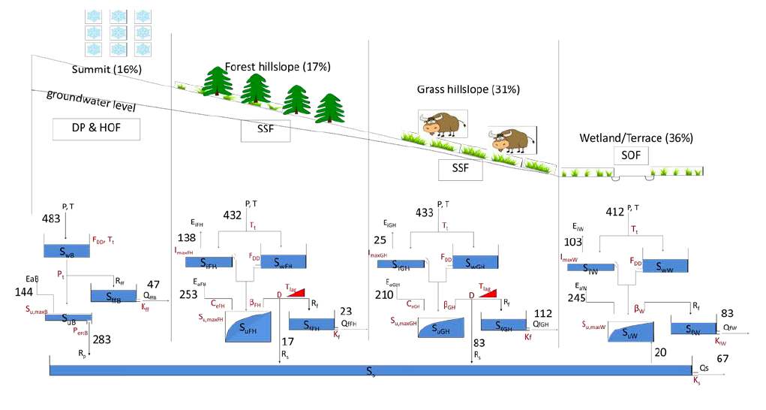
Landscape based model structure

Slide 28
How to test if the model structure is more realistic?
Less predictive uncertainty in Validation
Validation in Nested Sub-catchments

Slide 29
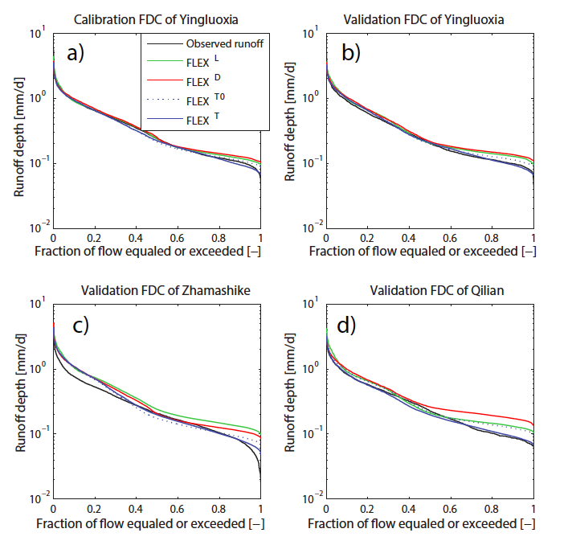

Slide 30
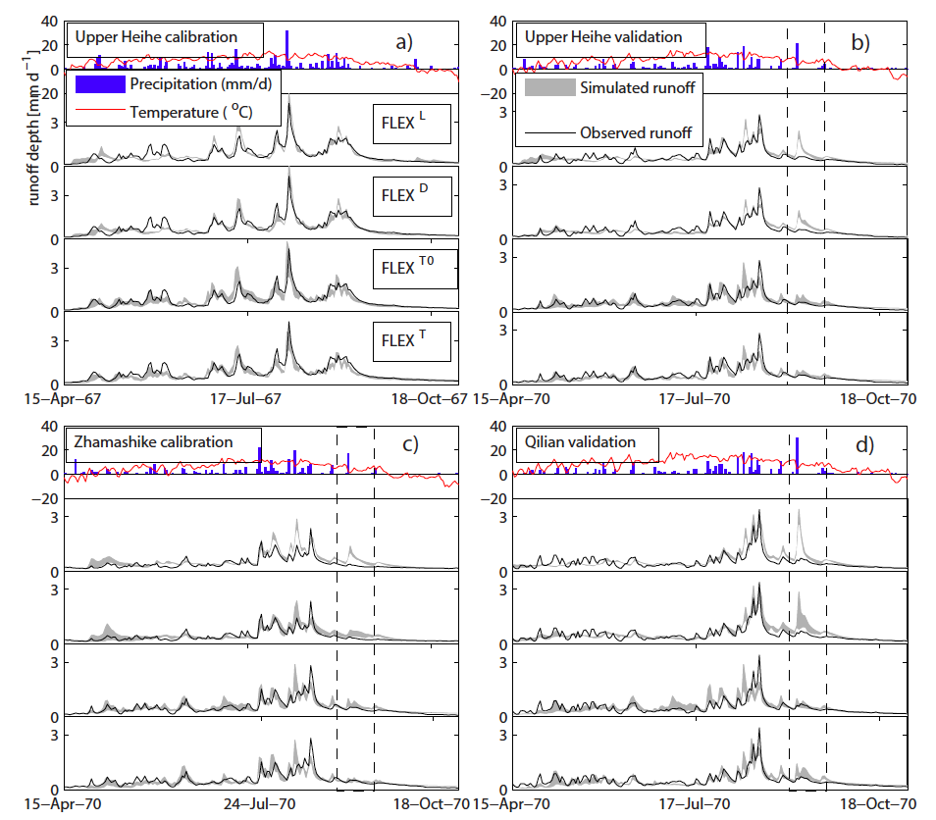

Slide 31
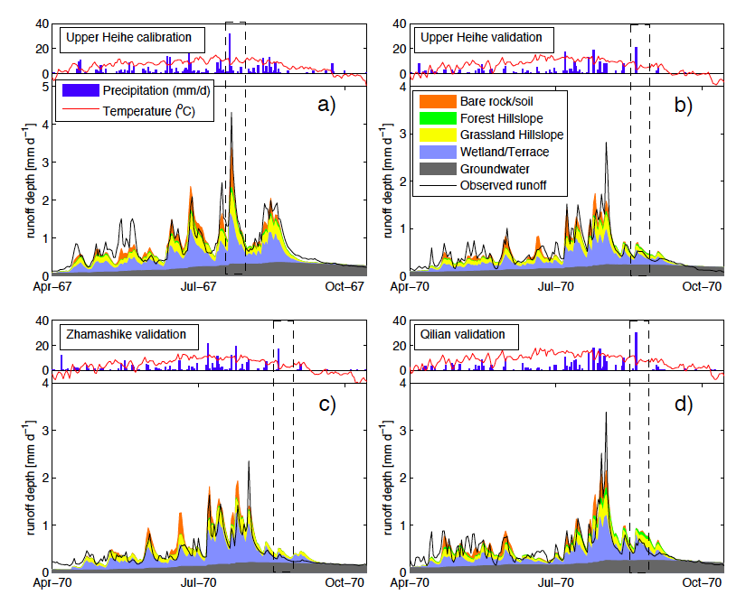

Slide 32
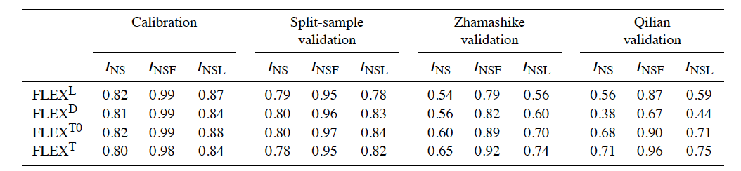
FLEX-topo outperforms in nested catchment validation
Landscape is crucial in up-scaling, down-scaling
or model transfer

Slide 33
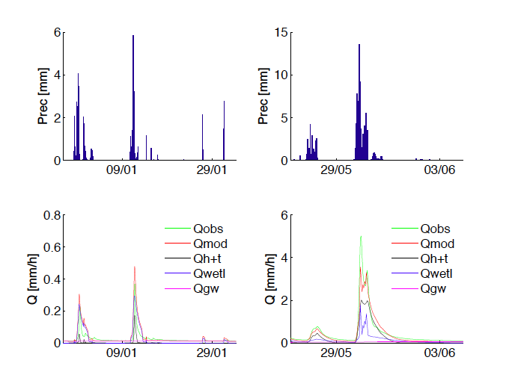
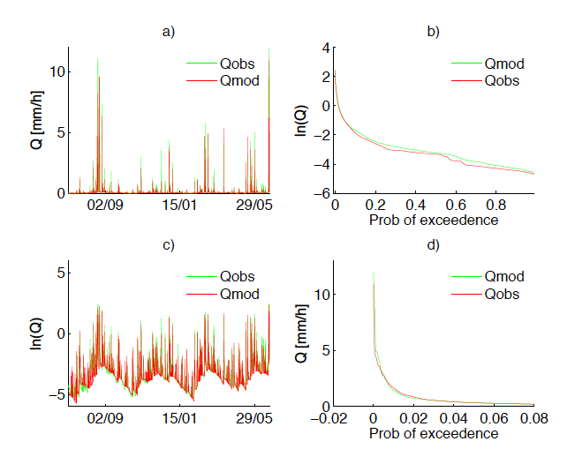
Other promising tests:
Mahurangi (N.Z.)
Meuse
Rhine
Chao Phya (Thailand)
Peninsular Malaysia
Umbeluzi (Moz)

Slide 34
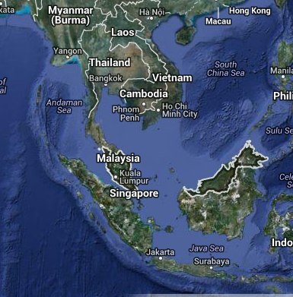
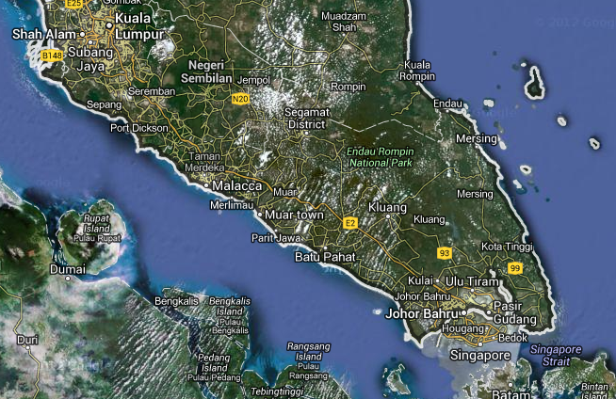

Endau catchment South East Malaysia
Ongoing work by Marijn Piet

Slide 35

Average daily discharge at three discharge stations (m3/s) (NB also year 2000 – 2003 are plotted here)

Slide 36



Endau, Malaysia

Slide 37




Catchment 2, smallest Q

Slide 38

Stevens Method
Or calibrate on:

Slide 39




Results

Slide 40
Landscape is the link between local and catchment scale
As a result of the different thresholds in different landscape classes, a much better distinction between wet and dry periods
Upscaling, downscaling and translocation is more reliable when accounting for the variable landscape composition
Patterns that are implicit in the landscape are retained and not broken up (as in distributed modelling)

Slide 41
Thank you

